Slide 1
8.0 Communication Systems
Modulation: embedding an information-bearing signal into a second signal
e.g.
x(t) : information-bearing signal
c(t) : carrier signal
y(t) = x(t)c(t) : modulated signal
purposes :
locate the signal on the right band of the spectrum
multiplexing : simultaneous transmission of more than
one signals over the same channel
resistance to noise and disturbance
demodulation : extracting the information-bearing
signal from the modulated signal

Slide 2
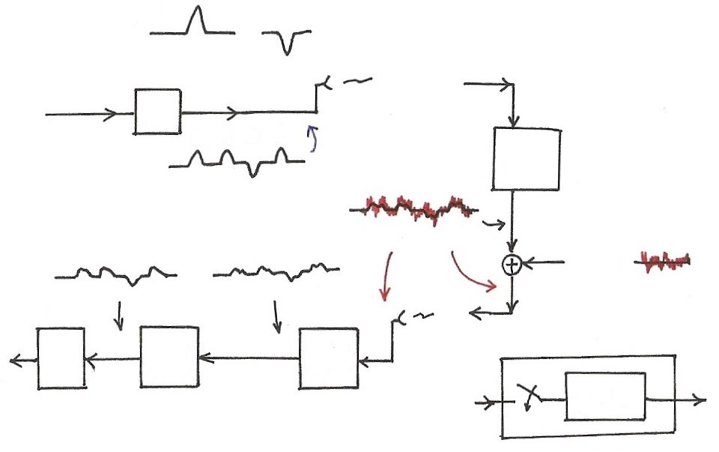
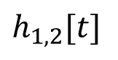
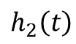
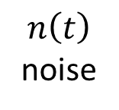
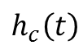
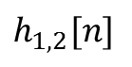
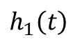
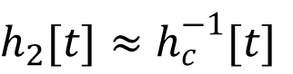
Data Transmission (p.111 of 2.0)
“1”
“0”
Transmitter
…1101 …
1 1 0 1
$$h_{c}\left(t\right)$$
channel distortion
$$n\left(t\right)$$
noise
…1101 …
$$h_{2}\left(t\right)$$
$$h_{1}\left(t\right)$$
$$h_{1,2}[n]$$
Decision
equalizer
front-end
filter
$$h_{2}[t]≈h_{c}^{−1}[t]$$
$$h_{1,2}[t]$$

Slide 3
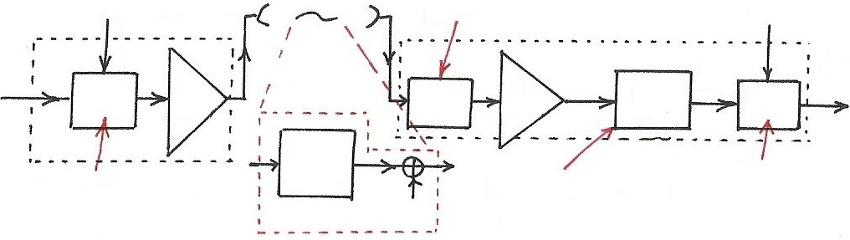
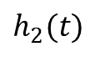
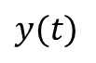
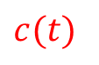
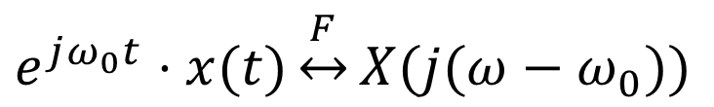
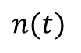
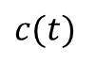
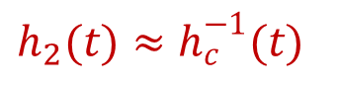

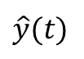
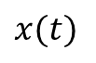
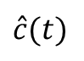
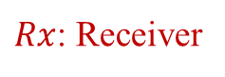
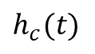
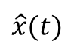
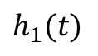
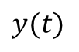
Communication
$$c(t)$$
front-end filter
$$\hat{c}(t)$$
$Tx$: Transmitter
$Rx$: Receiver
$$y(t)$$
$$\hat{y}(t)$$
$$y(t)$$
$$x(t)$$
$$\hat{x}(t)$$
Mod
Amp
$$h_{1}(t)$$
Amp
$$h_{2}(t)$$
Dem
$$h_{c}(t)$$
Modulation
equalizer
Demodulation
$$n(t)$$
$$h_{2}(t)≈h_{c}^{−1}(t)$$
channel
Modulation Property
$$c(t)$$
$$e^{jω_{0}t}⋅x(t)\underset{↔}{F}X(j(ω−ω_{0}))$$

Slide 4
8.1 Amplitude Modulation (AM) and Frequency-Division Multiplexing (FDM)
Complex Exponential Carrier
Modulation
information-bearing signal
Demodulation
See Fig. 8.1, p.584 of text

Slide 5
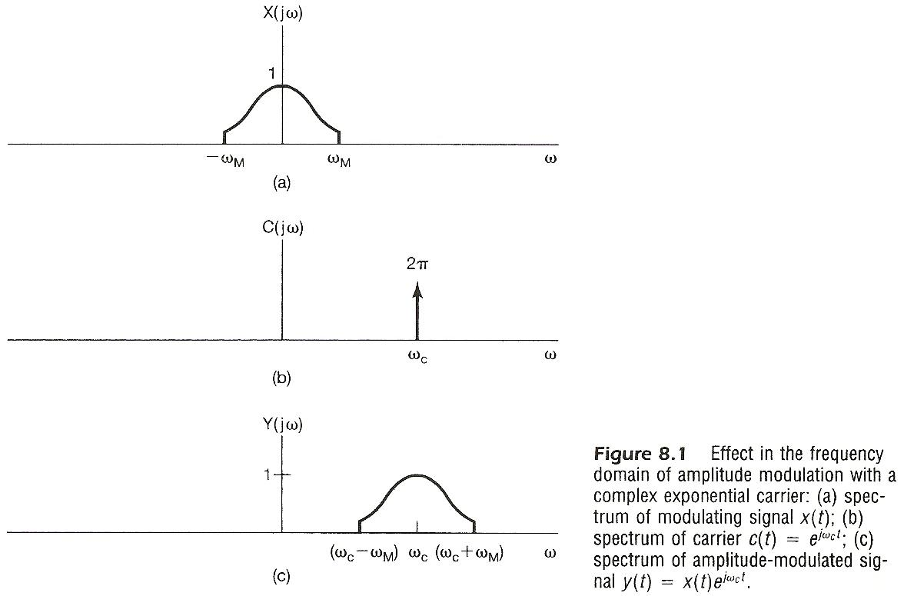

Slide 6
Sinusoidal Carrier
Modulation
See Fig. 8.4, p.586 of text

Slide 7
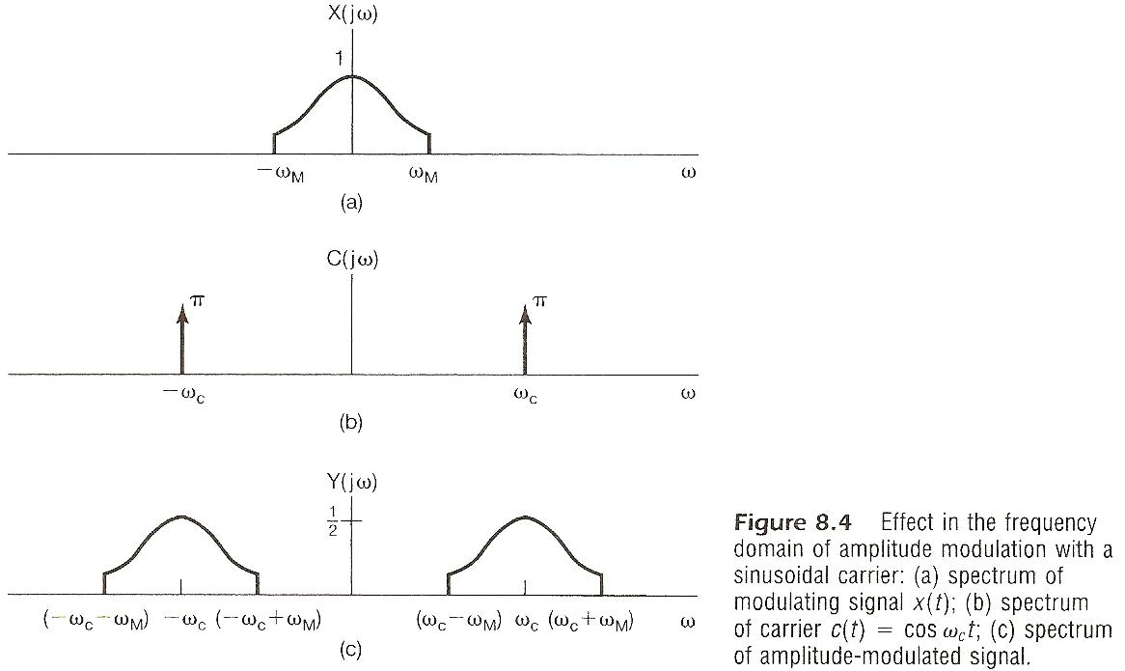

Slide 8
Sinusoidal Carrier
Demodulation
Synchronous demodulation (detection)
See Fig. 8.6, 8.8, p.588, 589 of text
A lowpass filter gives x(t)

Slide 9
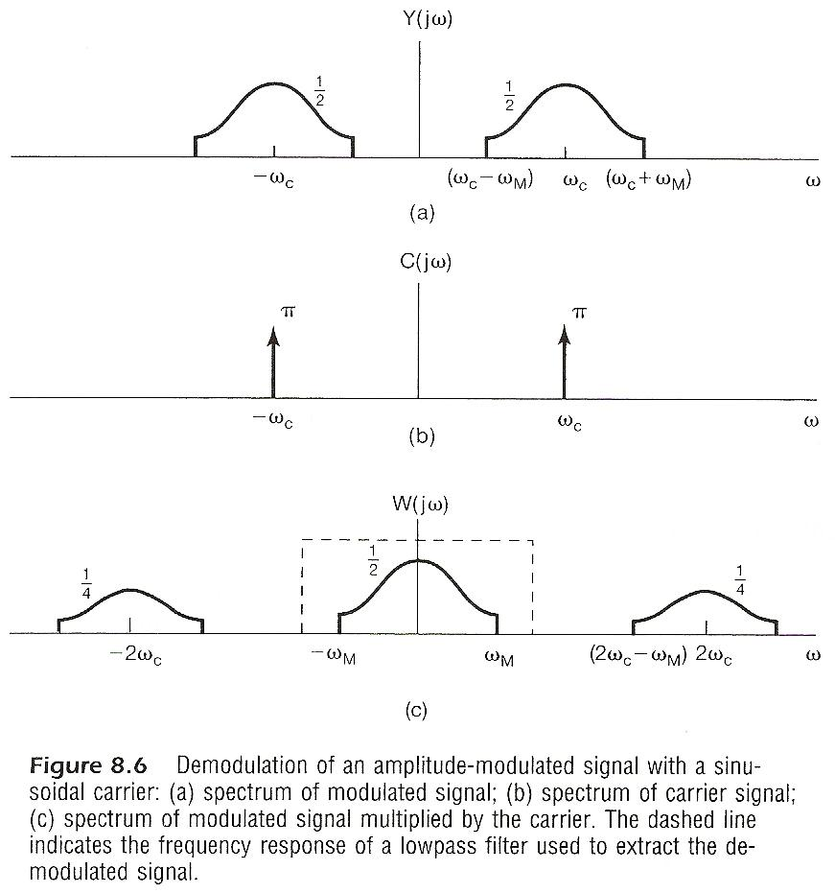

Slide 10
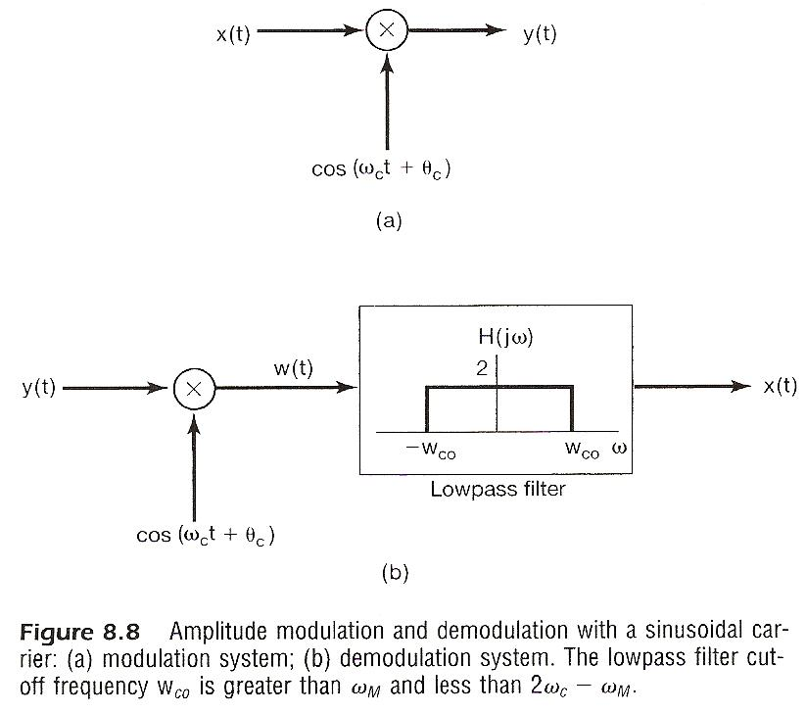

Slide 11
Sinusoidal Carrier
Demodulation
Synchronous demodulation (detection)
If the demodulating carrier is not in phase with the carrier
output signal reduced by
synchronization required.
phase-locked loops.

Slide 12
Sinusoidal Carrier
Demodulation
Asynchronous demodulation (envelope detection)
envelope (the smooth curve connecting the peaks) carries the information, can be extracted in some other ways
always positive
See Fig. 8.10, 8.11, p.591, 592 of text
the carrier component consumes energy but carries no information
See Fig. 8.14, p.593 of text

Slide 13
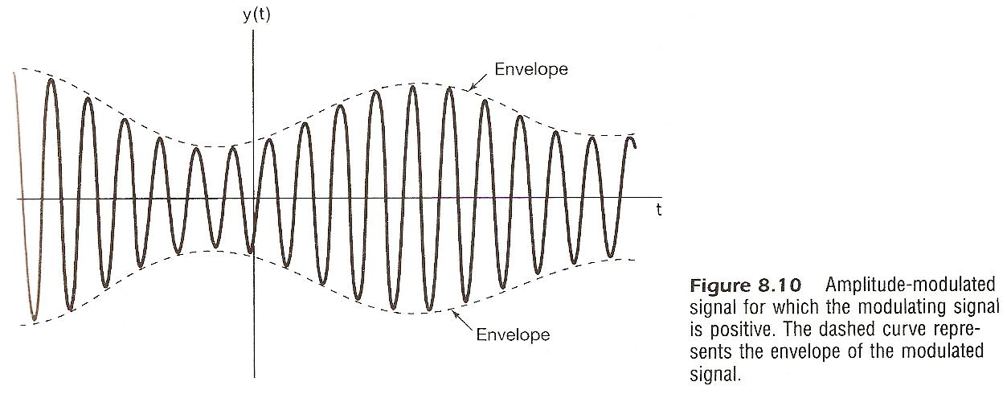

Slide 14
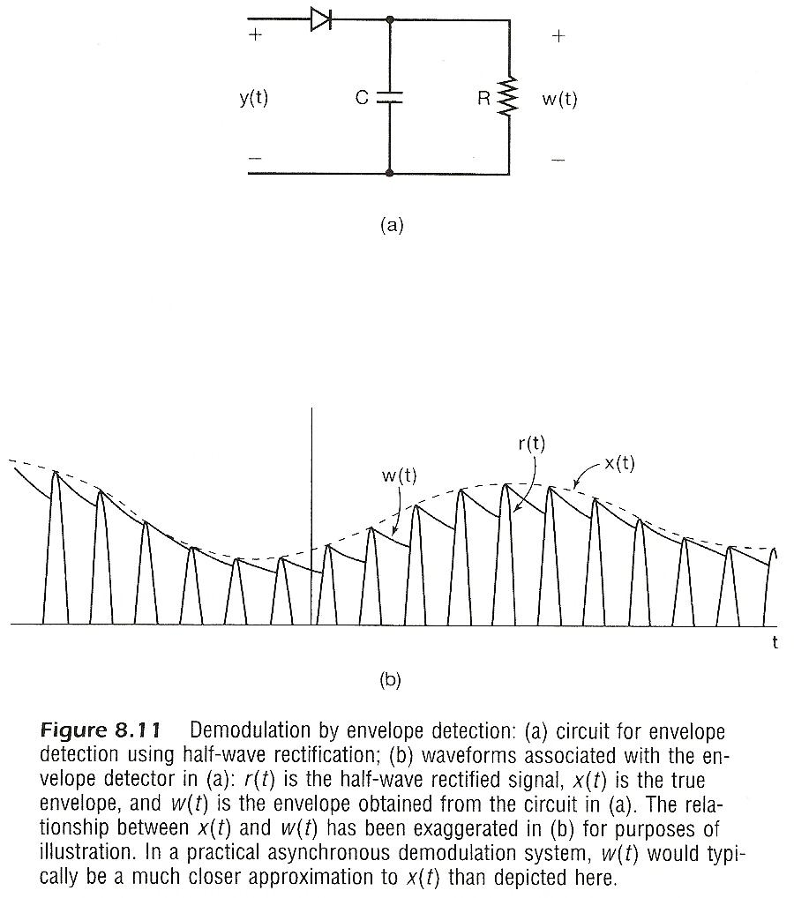

Slide 15
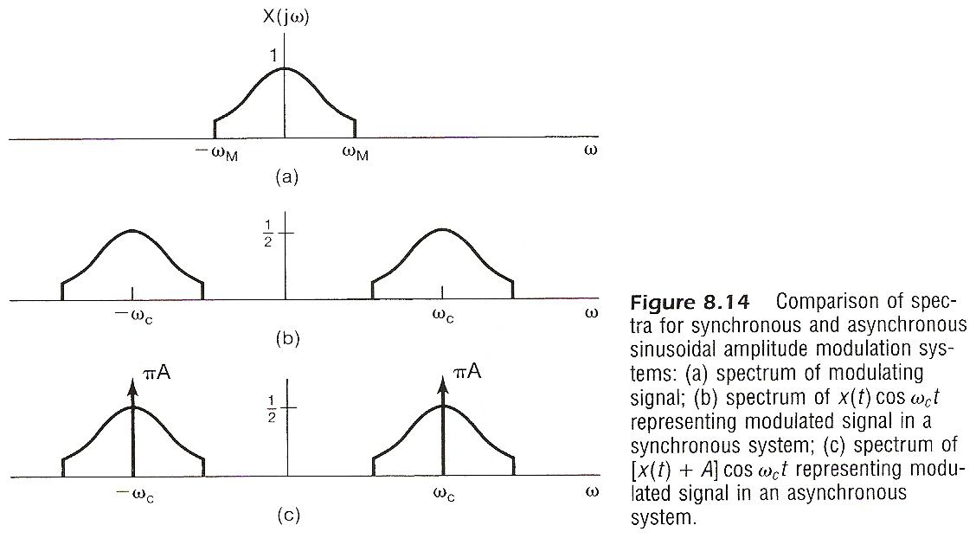

Slide 16
Sinusoidal Carrier
Double-sideband (DSB)/Single-sideband (SSB)
double-sideband modulation uses twice the bandwidth
DSB/WC (with carrier) , DSB/SC (suppressed carrier), upper-sideband, lower-sideband
See Figs. 8.19, 8.20, 8.21, 8.22, p.598-601 of text
a 90°phase-shift network can be used

Slide 17
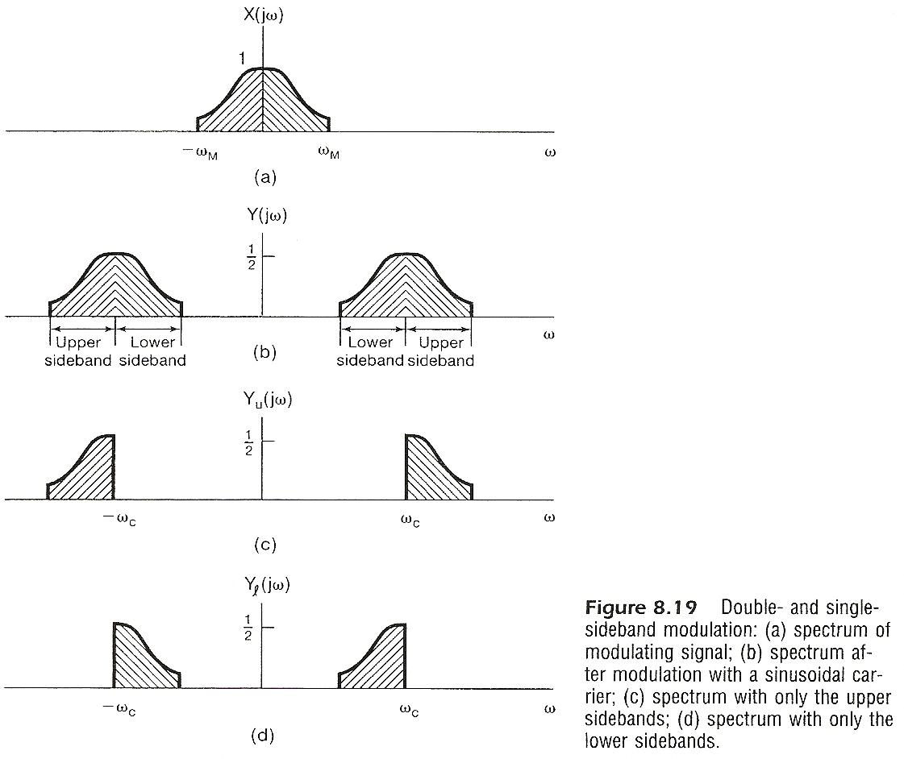

Slide 18
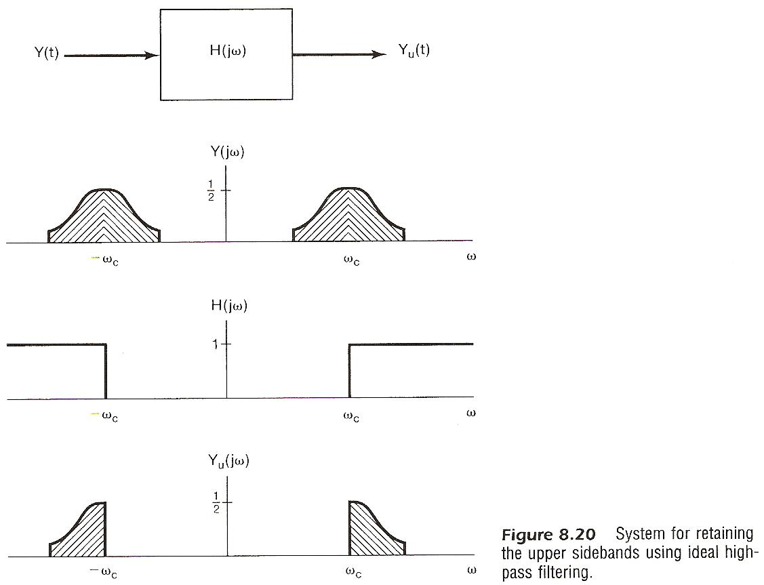

Slide 19
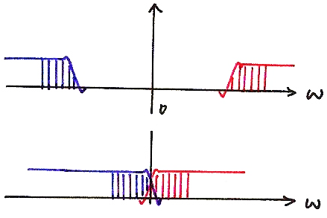
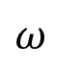
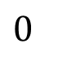
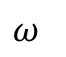
Vestigial Sideband
$$ω$$
$$0$$
$$ω$$

Slide 20
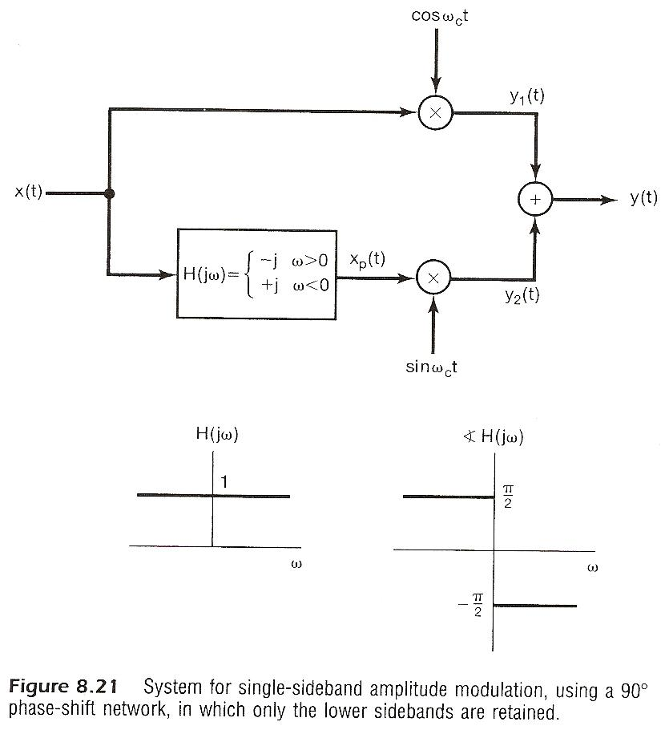

Slide 21
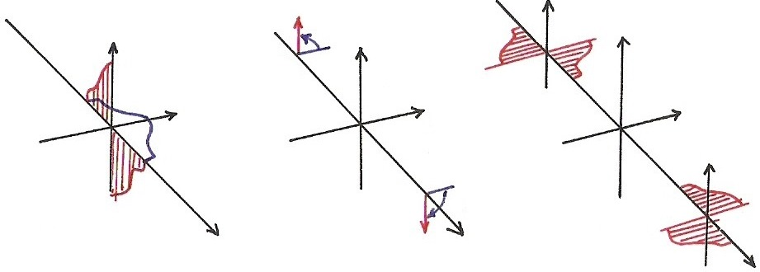
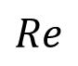
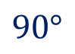
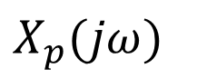
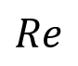
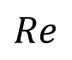
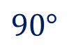
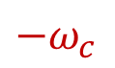
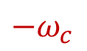
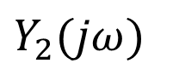
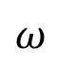
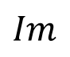







Phase Shift Network
$$Im$$
$$90°$$
$$Im$$
$$Im$$
$${−ω}_{c}$$
$${−ω}_{c}$$
$$Re$$
$$Re$$
$$Re$$
$$ω_{c}$$
$$90°$$
$$ω_{c}$$
$$X_{p}(jω)$$
$$ω$$
$$F(\sin{ω_{c}t})$$
$$ω$$
$$Y_{2}(jω)$$
$$ω$$

Slide 22


Slide 23
Frequency-Division Multiplexing (FDM)
each signal allocated with a frequency slot. Many signals transmitted simultaneously over a single wideband channel using a single set of transmission facilities
See Figs. 8.15, 8.16, 8.17, p.594-596 of text
See Fig. 4.27, p.326 of text
Signals mixed in time domain but separated in frequency domain.

Slide 24






Frequency Division Multiplexing
(p.67 of 4.0)
$$x_{1}(t)$$
$$X_{1}(jω)$$
$$X_{2}(jω)$$
$$x_{2}(t)$$
$$ω$$

Slide 25


Amp

Slide 26


Slide 27


Slide 28








FDM with SSB
$$ω$$
$$0$$
$$ω$$
$$ω_{c_{1}}$$
$$ω_{c_{2}}$$
$$ω_{c_{3}}$$
$$ω_{c_{4}}$$

Slide 29

(p.68 of 4.0)

Slide 30

(p.69 of 4.0)

Slide 31
8.2 Pulse Modulation and
Time-Division Multiplexing
Amplitude Modulation with a pulse train carrier
See Figs. 8.23, 8.24, p.602, 603 of text
A lowpass filter gives x(t) if sampling theorem is satisfied, ω_{c} > 2 ω_{M}

Slide 32


Slide 33






















Practical Sampling (p.19 of 7.0)
(any other pulse shape)
x(t)
$x_{p}$(t)
$$p(t)$$
$$τ$$
T
$x_{p}$(t)
1
x(t)
t
t
T
$$−T$$
0
t
t
$$T$$
$$τ$$
$$F$$
$$\frac{2π}{T}$$
T
$$F$$
$$F$$
$$\frac{2π}{T}$$
$$α\frac{1}{τ}$$
$$τ$$
$$P(jω)$$
$$ω$$
$$ω$$
$$ω$$
0
$$X_{p}(jω)$$
$$ω$$
0
$$\frac{2π}{T}$$

Slide 34


Slide 35
Amplitude Modulation with a pulse train carrier
This remains true as long as c(t) is periodic, represented by a sequence a_{k}. Sinusoidal AM is a special case here. Impulse train sampling is the case ∆ → 0.
Pulse-Amplitude Modulation
pulse amplitudes corresponds to the sample values
example : rectangular pulses (sample-and-hold)
See Fig. 8.26, p.606 of text
Sampling theorem applies.

Slide 36


Slide 37


























Practical Sampling (p.20 of 7.0)
$$x(t)$$
$$x_{p}\left(t\right)=\sum_{n}{x}\left(nT\right)p(t−nT)$$
$$τ$$
(any other
pulse shape)
$$x(t)$$
$$t$$
$$T$$
$$t$$
$$T$$
$$t$$
$$t$$
$$F$$
$$τ$$
$$F$$
$$\frac{2π}{T}$$
$$F$$
$$X(jω)$$
$$α\frac{1}{τ}$$
$$ω$$
$$ω$$
$$ω$$
$$X_{p}(jω)$$
$$ω$$
0
$$\frac{2π}{T}$$
$$ω$$
0
$$ω_{c}$$

Slide 38
Time-Division Multiplexing (TDM)
Each signal allocated with a time slot in a period T.
Many signals transmitted simultaneously over a single channel using a single set of facilities
See Figs. 8.25, 8.27, p.605, 606 of text
Signals mixed in frequency domain but separated in time domain.

Slide 39





Time Division Multiplexing (TDM)
$x_{1}(t)$
$x_{3}(t)$
$x_{2}(t)$
$$t$$

Slide 40


Slide 41


Slide 42
Intersymbol interference
pulses distorted during transmission and causing interference to adjacent symbols
See Figs. 8.28, 607 of text
Pulses with zero intersymbol interference
(1)
See Figs. 8.30, 609 of text

Slide 43

Intersymbol Interference
x[1]
x[2]
x[3]
It is the sample values rather than pulse shapes to be transmitted
Distortionless transmission via distorted channels
intersymbol interference

Slide 44


Slide 45


Slide 46
Intersymbol interference
Pulses with zero intersymbol interference
(2)
P₁(jw) with odd symmetry about
See Figs. 8.31, 610 of text

Slide 47



Slide 48
Pulse coded modulation (PCM)
binary representation of pulse amplitude (sample values) and binary transmission of signals
much more easier to distinguish between 1’s and 0’s

Slide 49
Date Transmission (p.111 of 2.0)
“1”
“0”
Transmitter
…1101 …
1 1 0 1
$$h_{c}\left(t\right)$$
channel distortion
$$n\left(t\right)$$
noise
…1101 …
$$h_{2}\left(t\right)$$
$$h_{1}\left(t\right)$$
$$h_{1,2}[n]$$
Decision
equalizer
front-end
filter
$$h_{2}[t]≈h_{c}^{−1}[t]$$
$$h_{1,2}[t]$$

Slide 50
8.3 Angle/Frequency Modulation
Angle Modulation
phase modulation (PM)
frequency modulation (FM)
phase modulation with x(t) corresponds to frequency modulation with dx(t)/dt

Slide 51












Angle Modulation
$$y(t)$$
$$y\left(t\right)=A\cos{(ω_{0}t+θ)}$$
$$t$$
$$θ(t)$$
$$y(t)$$
$$PM$$
$$x(t)$$
$$\frac{d}{dt}x(t)$$
$$y(t)$$
$$\frac{d}{dt}$$
$$FM$$

Slide 52
Angle Modulation
instantaneous frequency
phase modulation
frequency modulation
Highly nonlinear process See Figs. 8.32, p.612 of text
features
constant envelope: transmitter always operates at peak power
information not carried by amplitudes : amplitude disturbances eliminated to a large extent

Slide 53


Slide 54








Fig. 8.32
(a)
(b)
$$ω_{c}$$
$$ω_{c}$$
$$t$$
$$t$$
(c)
Instantaneous frequency
$$ω_{c}$$
$$ω_{i}\left(t\right)=\frac{d}{dt}θ(t)$$
$$t$$

Slide 55
Spectrum of FM Signals
Consider the easiest case
Narrowband FM, m << π/2
See Figs. 8.33, 8.34, p.615 of text

Slide 56










Narrowband FM vs. DSB/WC
$$y_{2}\left(t\right)=[1+m\cos{ω_{m}t}]\cos{ω_{c}t}$$
$=[1+x(t)]\cos{ω_{c}t}$
$$ω$$
${−ω}_{m}$ 0 $ω_{m}$
$$Y_{2}(jω)$$
$$ω$$
${−ω}_{c}$
0
$ω_{c}$
$${−ω}_{c}+ω_{m}$$
$$ω_{c}+ω_{m}$$

Slide 57





















Narrowband FM
$$Im$$
$${−ω}_{c}$$
$$Re$$
$$Im$$
$$Im$$
$${−ω}_{c}$$
$$Re$$
$${−ω}_{m}$$
$$Re$$
$$ω_{m}$$
0
$$Im$$
$$ω_{c}$$
$$Re$$
$$ω_{c}$$
$$ω$$
$$ω$$
$$F(\sin{ω_{m}t})$$
$$F(\sin{ω_{c}t})$$
$$ω$$
$$F[\left(\sin{ω_{m}t}\right)\left(\sin{ω_{c}t}\right)]$$

Slide 58


Slide 59


Slide 60
Spectrum of FM Signals
Wideband FM , m not small
cos(m sin ω_{m}t), sin(m sin ω_{m}t)
periodic with fundamental frequency ω_{m}
with spectrum of impulses at multiples of ω_{m}
See Figs. 8.35, p.616 of text
n-th harmonics considered negligible, | n | > m

Slide 61


Slide 62
Spectrum of FM Signals
Example : periodic square wave signal
See Figs. 8.36-8.39, p.617, 618 of text

Slide 63


Slide 64


Slide 65


Slide 66


Slide 67
8.4 Discrete-time Modulation
Complex exponential carrier
See Figs. 8.41, p.620 of text
Complex exponential carrier
See Figs. 8.42, 8.43, p.621, 612 of text
Example : Software Defined Radio

Slide 68
















Discrete-time Realization of Continuous-time Modulation
$$y\left(t\right)=A\cos{[θ\left(t\right)]}$$
$$y(t)$$
$$\hat{y}(t)$$
$$y[n]$$
$$\hat{x}(t)$$
$$x(t)$$
FM
Mod
FM
Dem
$$t$$
$$y[n]=A\cos{(θ\left[n\right])}$$
$$x(t)$$
$$x[n]$$
Discrete-time
Mod
Dem
$$y(t)$$
$$\hat{x}(t)$$
$$\hat{y}(t)$$
$$\hat{y}[n]$$
$$\hat{x}[n]$$
FM Mod
FM Dem

Slide 69


Slide 70


Slide 71


Slide 72
















Problems
Problem 8.25, p.633 of text
Frequency inverter as a speech scrambler for secure speech communication
$$x(t)$$
$$y(t)$$
$$ω$$
$${−ω}_{M}$$
$$ω_{M}$$
$$\cos{ω_{M}t}$$
$${−ω}_{k}$$
$$ω_{k}$$
$${−ω}_{M}$$
$$ω_{M}$$
$$ω$$
0
$$ω_{M}−ω_{k}$$
$$ω$$
$${−ω}_{M}$$
0
$$ω_{M}$$
Inverse system is itself

Slide 73

Problems
Problem 8.34, p.640 of text
Implementing AM with a nonlinear element (multiplier is difficult to implement)
removed by filtering

Slide 74

Problems
Problem 8.39, p.645 of text
Frequency Shift Keying (FSK) for digital transmission

Slide 75
Data Transmission (p.111 of 2.0) (p.2 of 8.0)
“1”
“0”
Transmitter
…1101 …
1 1 0 1
$$h_{c}\left(t\right)$$
channel distortion
$$n\left(t\right)$$
noise
…1101 …
$$h_{2}\left(t\right)$$
$$h_{1}\left(t\right)$$
$$h_{1,2}[n]$$
Decision
equalizer
front-end
filter
$$h_{2}[t]≈h_{c}^{−1}[t]$$
$$h_{1,2}[t]$$

Slide 76
Problems
Problem 8.39, p.645 of text
(a)
“orthogonal” but evaluated in a period of T
(b)
when T is a common multiple of the periods of
both and

Slide 77


Problems
Problem 8.40, p.646 of text
Quadrature multiplexing

Slide 78
Problems
Problem 8.40, p.646 of text

Slide 79











Sinusoidals
(p.25 of 4.0)
$\cos{ω_{0}t}\underset{↔}{F}π\left[δ\left(ω−ω_{0}\right)+δ\left(ω+ω_{0}\right)\right],$ $\frac{1}{2}[e^{jω_{0}t}+e^{−jω_{0}t}]$
$\sin{ω_{0}t}\underset{↔}{F}\frac{π}{j}\left[δ\left(ω−ω_{0}\right)−δ\left(ω+ω_{0}\right)\right],$ $\frac{1}{2j}[e^{jω_{0}t}−e^{−jω_{0}t}]$
$$Im$$
$$\cos{ω_{0}(t−t_{0})}$$
$$\sin{ω_{0}t}$$
$${−ω}_{0}$$
$$Re$$
$$ω_{0}$$
$$\cos{ω_{0}t}$$
$$ω$$
$$x\left(t−t_{0}\right)↔e^{−jω_{0}t}⋅X(jω)$$

Slide 80
















Problems
Problem 8.40, p.646 of text
$$F[\cos{ω_{c}}{t}]$$
$$F[r(t)\cos{ω_{c}}{t}]$$
$$Im$$
$$Im$$
$$X_{1}(jω)$$
$$Im$$
$$Re$$
$$Re$$
$$Re$$
$$X_{2}(jω)$$
$$ω$$
$$ω$$
$$F[\sin{ω_{c}t}]$$
$$ω$$
$$F[r(t)\cos{ω_{c}}{t}]$$

Slide 81











Problems
Problem 8.44, p.649 of text
Zero-forcing equalizer for pulse transmission
$$p(t)$$
$$x(t)$$
$$y(t)$$
$$x(t)$$
$$T_{1}$$
$$T_{1}$$
$$T_{1}$$
$$a_{−N}$$
$$a_{N}$$
$$y(t)$$

Slide 82
Intersymbol Interference
(p.43 of 8.0)
x[1]
x[2]
x[3]
It is the sample values rather than pulse shapes to be transmitted
Distortionless transmission via distorted channels
intersymbol interference

Slide 83
Problems
Problem 8.44, p.649 of text
Requirement:
…
Example:

